Slide 1





HELPING ON FIND PARKING SLOTS USING CITY STREET CAMERAS
Carolina Chacon¹, Adriano Lima e Souza¹, Maira B. Moran², and Aura Conci¹
¹Federal Fluminense University-UFF
²Universidade do Estado do Rio de Janeiro-UERJ

Slide 2
Agenda
Introduction
Objective
Materials and Methods
Results
Conclusion and Future works

Slide 3
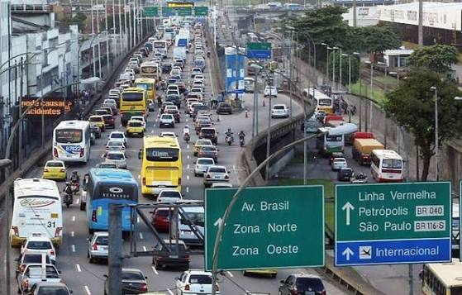
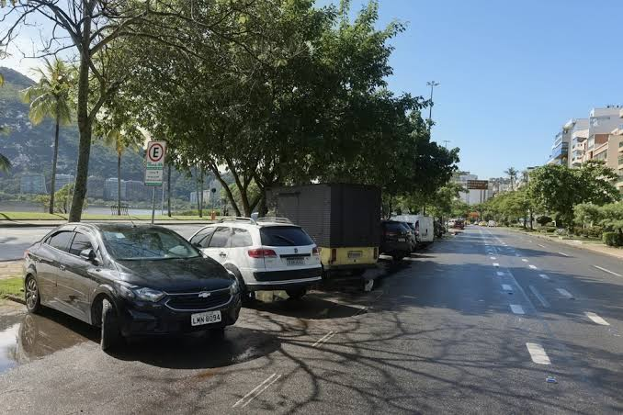
Introduction
Approximately 70% of Brazilian families owning own at least one car in the beginning of this decade
Difficulty of finding parking spaces
Need for more effective help for urban parking
This research presents an application of image analysis and signal processing to interpret and extract meaningful information from digital scenes

Slide 4
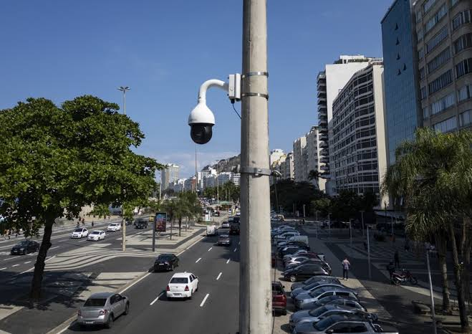
Urban surveillance
Large dissemination of digital cameras around the city environment
Volume of available visual data has grown exponentially

Slide 5
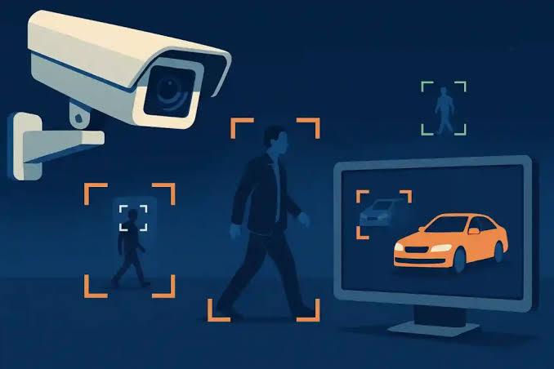
Computer vision
New techniques and technologies emerge
Advances in visual perception and data interpretation
Machine learning (ML) and artificial intelligence (AI) algorithms
Impressive results in classification and recognition of objects or patterns in images

Slide 6
The main objective is to enable the identification, recognition, and monitoring of available parking spaces in landscapes

Slide 7
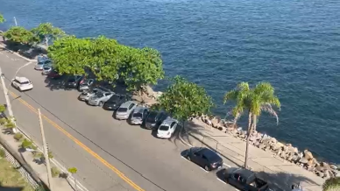
Materials
Dataset
Outdoor scenes of two real cities in Brazil: Niteroi and São Gonçalo
Images extracted from videos captured by smartphones
Diverse scenarios for adequate pattern recognition:
Covered or uncovered environments
Non homogeneous illumination
Day and night time scenarios.
Broad variation of camera positions
May have marked vehicle parking spaces
Car parking slots which can be in different orientations
Direction of the traffic roads (parallel to the circulation)
Orthogonal
45 degrees direction

Slide 8
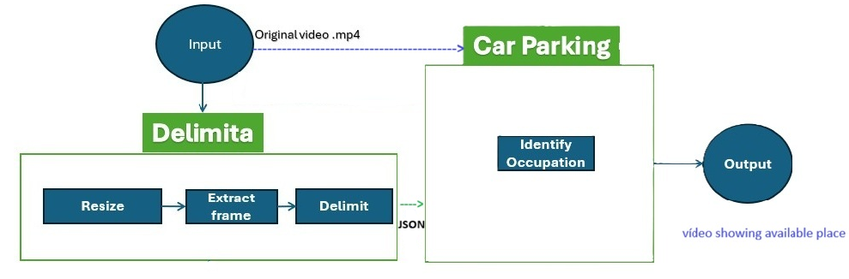
Proposed method
Two main steps:
1 - Delimita: pre-processing, using resources to highlight contours;
2 - Car parking: a processing with the objective of detecting parking spaces by identifying whether the space found is occupied or available and free for parking

Slide 9
First step: delimita
Pre-processing techniques applied to treat dataset images and preparing them for the analysis
Delimit the edges of possible slots for parking (json file)

Slide 10
First step: delimita
Resize
  From 3840 × 2160 to 1600 × 900 pixels
Pre-processing
  High-pass filtering
    Emphasize high frequencies (such as edges and fine details)
    Attenuating low frequencies (such as uniform or smooth area)
  Histogram normalization
    Redistribute intensity levels, improving the visibility of details in low-contrast images features
  Edge enhancement with Sobel filter
    Isolate edges and help to find line delimiting the parking places
Create JSON file with parking region described as an (id) and a list of pixel coordinates of the marked points

Slide 11
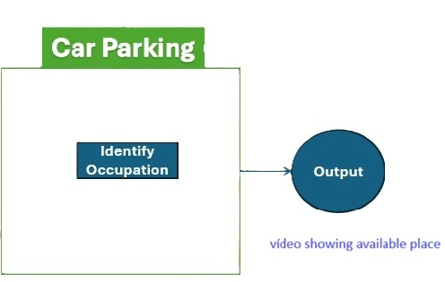
Second step: car parking
Two processing approaches evaluated:
Image processing techniques:
Segmentation and wavelets transforms
Irregular efficiency for different cases
Same processing time for spaces search than machine learning
Machine Learning
You Only Look Once (YOLO) neural network for object detection and segmentation

Slide 12
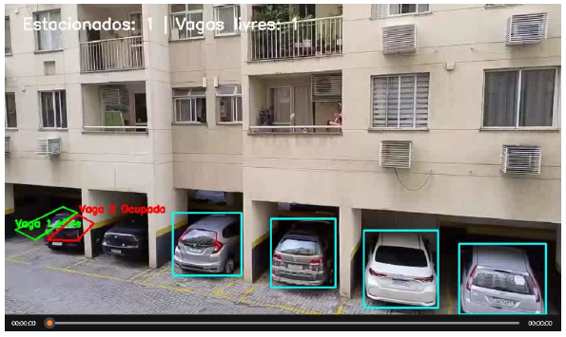
Second step: car parking
Detects occupancy by recognizing vehicle patterns and defining whether the delimited parking space is free or occupied
Space limits are displayed by solid red lines with the text ”Space ID: Occupied” or green in the video with the text: ”Space ID: Free”

Slide 13
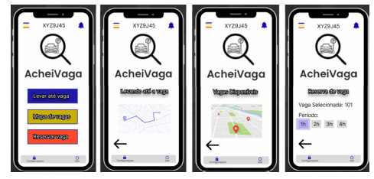
Interface: AcheiVaga
Cloud-hosted architecture
Developed in Figma

Slide 14
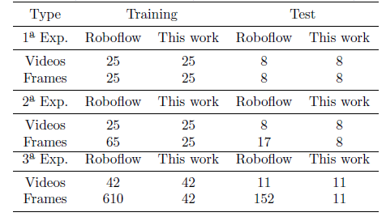
Results
Comparison with Roboflow
Three types of experiments
  Same set of 32 or 53 videos
  25 or 42 for learning and 8 or 11 different videos for testing
  Number of frames per video used defined automatically by the program in comparative analysis.

Slide 15
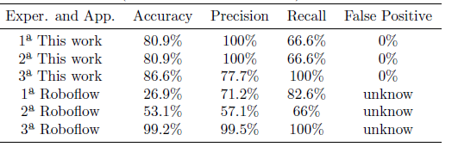
Results
No difference between first and second experiments (one frame per video used) for our solution
No False Positives answers

Slide 16
Conclusions and future works
The integration of of traditional and new methods allows the detection of parking space;
Despite the challenges faced, the results obtained demonstrated the feasibility and effectiveness of the proposed approach;
Future works
  Increase of the size and diversity in dataset
  Inclusion of a multiclass output related to the type of parking;
  Comparison with more possible availability solution or other datasets;
  A survey using this first version;
  Enhancing the app’s privacy and security features;
  Solve challenges related to technical feasibility and time response:
  Testing with official city cameras as well as private ones;
  Inclusion of more perpendicular and even distance images (drone, orthophotos and even satellite images)
  Remote servers on the internet

Slide 17
References
Yolov8: State-of-the-art computer vision model, 2025. URL https://yolov8.com/.
A. Conci, E. Azevedo, and F. R. Leta. Computa¸c˜ao Gr´afica, Volume 2: Processamento e An´alise de Imagens Digitais. Elsevier, Rio de Janeiro, Brasil, 3 edition, 2020. ISBN 978-85-352-8583-3.
C. Chacon. Prototipo do aplicativo acheivaga - Figma. https://www.figma.com/design/KkRZgtMPMPTh4stRvrRMH7/Aplicativo-AcheiVaga?node-id=0-1&p=f&t=2bKViO2ksMt7W2XN-0, 2025. Accessed: 2025-10-01.
Roboflow Inc. Roboflow: The platform for building computer vision models. https://roboflow.com, 2025. Accessed: 2025-10-01.
Secretaria Municipal de Urbanismo e Mobilidade, Prefeitura de Niterói. Biblioteca da secretaria municipal de urbanismo e mobilidade. https://urbanismo.niteroi.rj.gov.br/biblioteca.php, 2024

